Slide 1





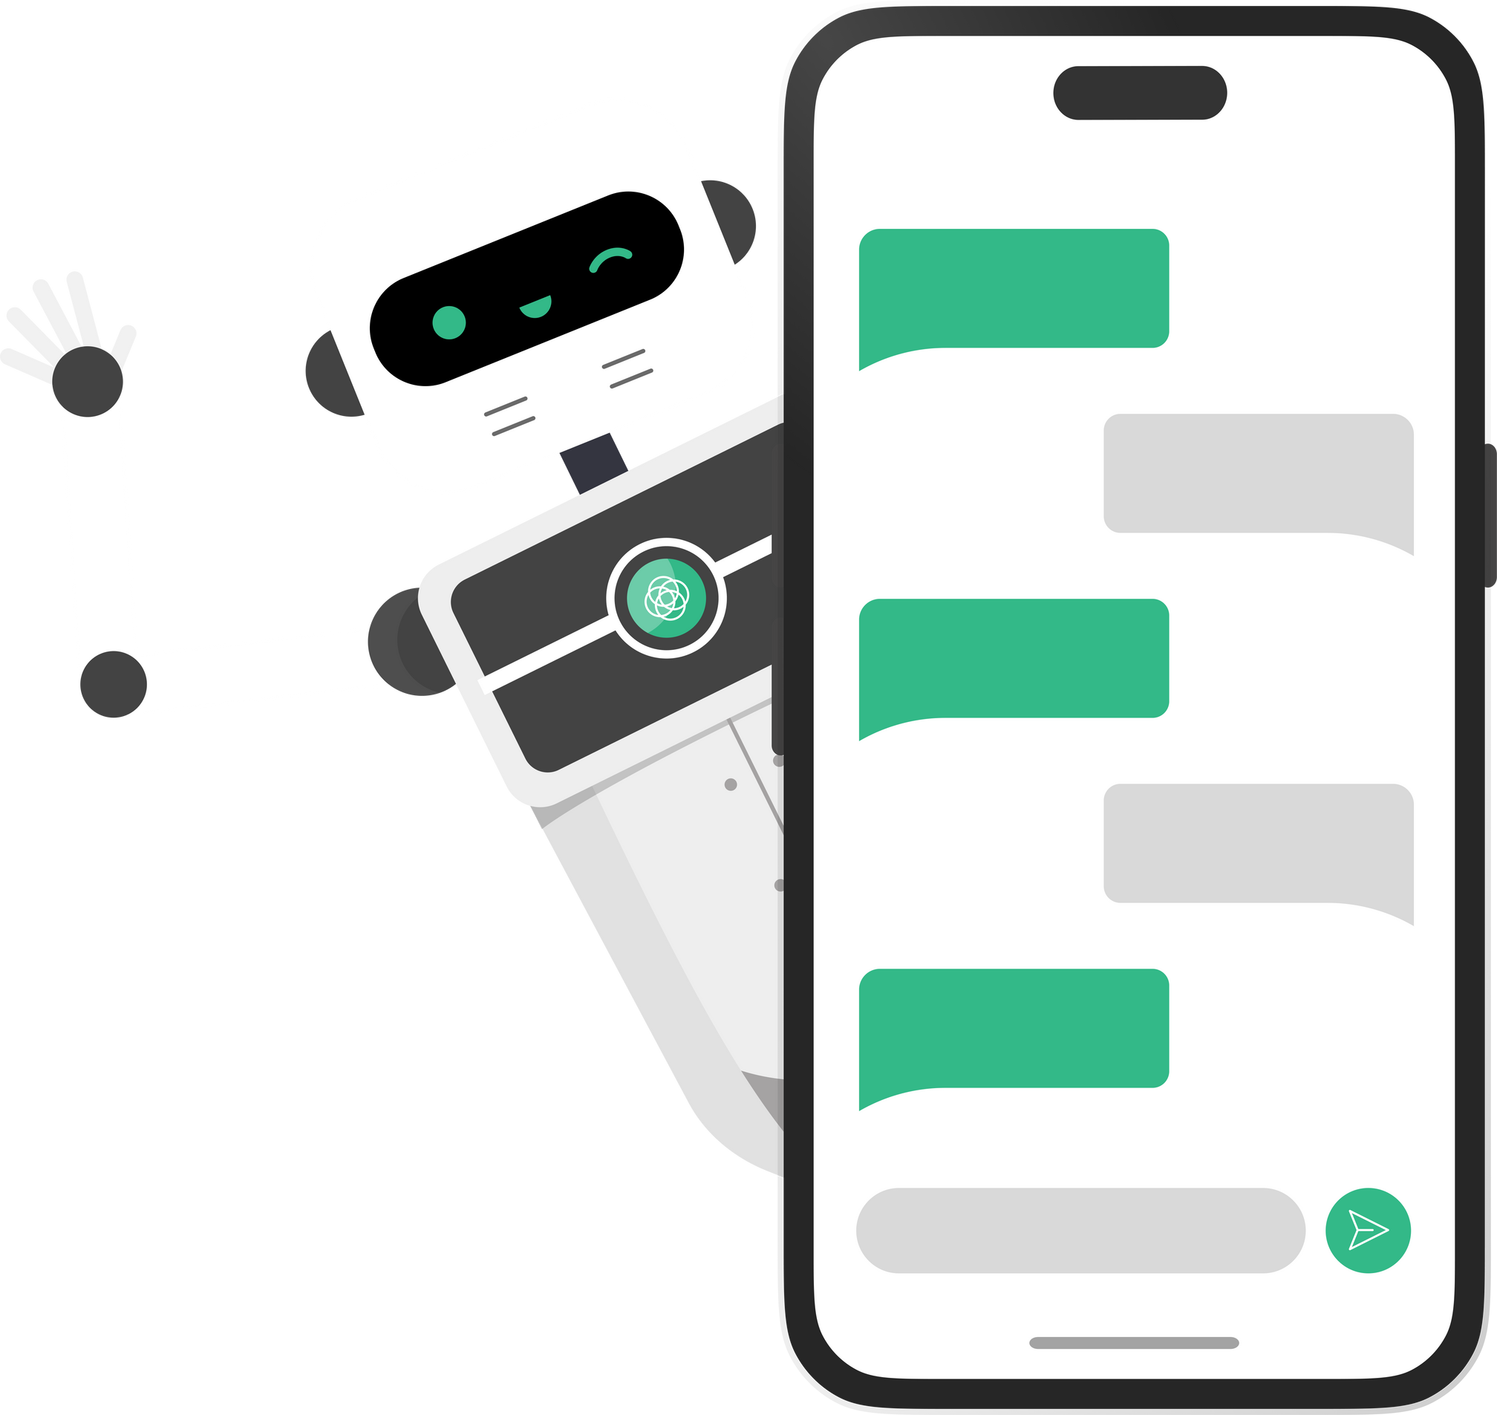
TITLE:
Enhancing ChatGPT for Interpretable Text Classification
Presented by:
Md Mahbub Alam Prithibi
ID:20101243

Slide 2
01
INTRODUCTION
02
METHODOLOGY
TABLE OF CONTENT:
03
CONVERTING KNOWLEDGE TO TEXT GRAPH
04
TEXT GRAPH BASED TEXT CLASSIFICATION
05
EXPERIMENTS
06
EVALUATION ON INTERPRETABILITY

Slide 3
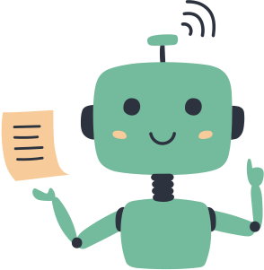

INTRODUCTION
ChatGPT, a powerful language model, excels in NLP tasks.
Limitations: Inflexible finetuning, lack of interpretability.
Proposal: Novel framework for text classification with interpretability.

Slide 4
METHODOLOGY
01
Knowledge Graph Extraction Task:
Extract refined knowledge using ChatGPT.
Convert knowledge into a graph for training an interpretable linear classifier.
02
Text Refinement:
Correct grammar, replace synonyms, clarify sentence structure.
Task-specific prompts for better understanding.
03
Knowledge Graph Extraction:
Chain of thoughts prompt for entity and relation identification.

Slide 5

CONVERTING KNOWLEDGE TO
TEXT GRAPH:
Building a text graph (G) with semantic information.
Nodes represent words, edges represent relationships.
Enhances interpretability and eliminates the need for black-box models.

Slide 6
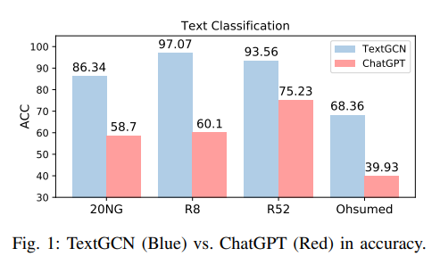
TEXT GRAPH BASED TEXT CLASSIFICATION:
Adopt Graph Convolution Networks (GCN) for classification.
One-layer GCN for interpretability.
Linear model without non-linear activation functions.
Integration with external knowledge (TF-IDF) for further enhancement.

Slide 7

EXPERIMENTS:
Four benchmark datasets: 20NG, R8, R52, Ohsumed.
Baselines: TF-IDF+LR, TextGCN, ChatGPT (k-shot).
ChatGraph outperforms in both performance and interpretability.

Slide 8

EVALUATION ON INTERPRETABILITY:
Quantitative fidelity metrics demonstrate accurate interpretation.
Qualitative analysis of sample cases highlights the model's capability to identify critical words.

Slide 9
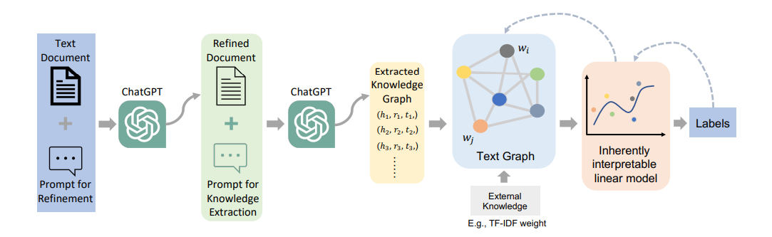
FIG. 2: CHATGRAPH FRAMEWORK FOR INTERPRETABLE TEXT CLASSIFICATION

Slide 10
CONCLUSION
ChatGraph enhances ChatGPT for text classification with interpretability.
Improved performance compared to other baselines.
Potential for broader applications in NLP tasks.
Future exploration of interpretability in ChatGPT.

Slide 11

THANK YOU!

